Slide 1
Recursion
Reading: Chapter 5
Data Structures and
Algorithms in Java

Slide 2
Recursion
Iterative: a programming technique in which you describe actions to be repeated using loops.
recursion: a programming technique in which you describe actions to be repeated using a method that calls itself.
Solving a problem using recursion depends on solving smaller occurrences of the same problem.
Writing methods that call themselves to solve problems recursively is called recursive programming
A different way of thinking of problem
An equally powerful substitute for iteration (loops)
Can solve some kinds of problems better than iteration
Leads to elegant, simplistic, short code (when used well)
Many programming languages (such as Haskell) use recursion exclusively (no loops)
Notes:
We have seen that repetition can be achieved by writing loops, such as for loops
and while loops. Another way to achieve repetition is through recursion, which
occurs when a function refers to itself in its own definition. We have seen examples
of functions calling other functions, so it should come as no surprise that most
modern programming languages, including C++, allow a function to call itself. In
this section, we see why this capability provides an elegant and powerful alternative
for performing repetitive tasks.

Slide 3
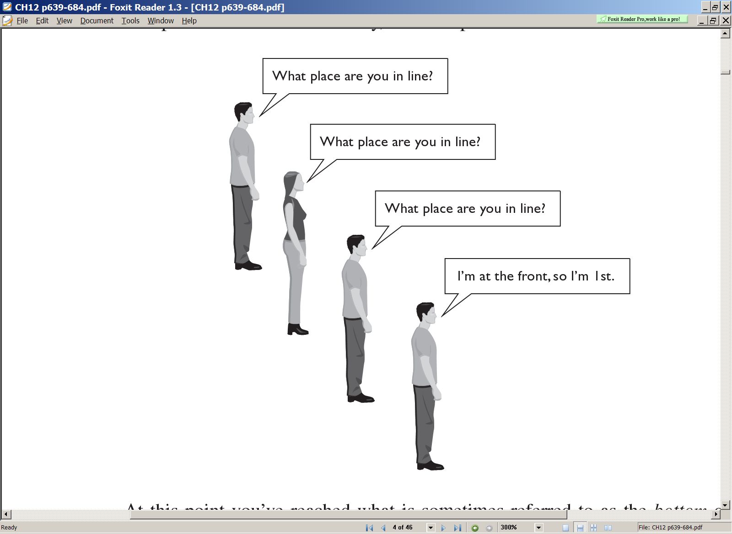
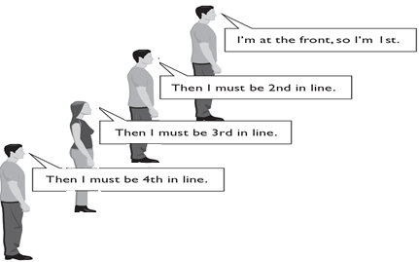
A Non Programming Idea and Example
Recursion is all about breaking a big problem into smaller occurrences of that same problem.
To find out what place you are in a long line of people.
If you cannot see the front of the line, you could ask the person in front of you.
To answer your question, this person asks the person in front of him/her, and so on.
Once the front person answers their place in line (first), this information is handed back, one person at a time, until it reaches you.

Slide 4
Recursion and cases
Every recursive algorithm involves at least 2 cases:
base case: A simple occurrence that can be answered directly.
Recursive function normally begins by testing for a set of base cases (there should be at least one).
recursive case: A more complex occurrence of the problem that cannot be directly answered, but can instead be described in terms of smaller occurrences of the same problem.
Define each possible recursive call so that it makes progress towards a base case.
Some recursive algorithms have more than one base or recursive case, but all have at least one of each.
A crucial part of recursive programming is identifying these cases.

Slide 5
Linear Recursion
it makes at most one recursive call each time it is invoked.
The function may have several possible recursive calls to make, but it should ultimately make just one of these calls
methodName (argument n) {
if ( condition is satisfied) //Base Case
Solution(n);
}
else
{
pre-processing(n);
methodName (n); // recursive-calls
post-processing(n);
}
}
Whenever a method is called, its arguments and post-processing code including return value are pushed on a stack. When the method returns (base case is reached), these values are popped from the stack

Slide 6
Simple example
Consider the following method to print a line of * characters:
// Prints a line containing the given number of stars.
// Precondition: n >= 0
public static void printStars(int n) {
for (int i = 0; i < n; i++) {
System.out.print("*");
}
System.out.println(); // end the line of output
}
Write a recursive version of this method (that calls itself).
Solve the problem without using any loops.
Hint: Your solution should print just one star at a time.

Slide 7
Handling cases
What are the cases to consider?
What is a very easy number of stars to print without a loop?
Handling additional cases, with no loops (in a bad way assuming n=4 at max):
public static void printStars(int n) {
if (n == 1) {
// base case; just print one star
System.out.print("*");
} else if (n == 2) {
System.out.print("*");
System.out.print("*");
} else if (n == 3) {
System.out.print("*");
System.out.print("*");
System.out.print("*");
} else if (n == 4) {
System.out.print("*");
System.out.print("*");
System.out.print("*");
System.out.print("*");
}
System.out.println();
}

Slide 8
Handling cases with some recursion
Taking advantage of the repeated pattern (somewhat better):
public static void printStars(int n) {
if (n == 1) {
// base case; just print one star
System.out.println("*");
} else if (n == 2) {
System.out.print("*");
printStars(1); // prints "*“
} else if (n == 3) {
System.out.print("*");
printStars(2); // prints "**“
} else if (n == 4) {
System.out.print("*");
printStars(3); // prints "***“
}
}

Slide 9
Using recursion properly
Condensing the recursive cases into a single case:
public static void printStars(int n) {
if (n == 1){
// base case; just print one star
System.out.println("*"); }
} else {
// recursive case; print one more star
System.out.print("*");
printStars(n - 1);
}
}
Recursion Zen: The art of properly identifying the best set of cases for a recursive algorithm and expressing them elegantly.
public static void printStars(int n) {
if (n == 0) {
// base case; just print one star
System.out.println();
}else {
// recursive case; print one more star
System.out.print("*");
printStars(n - 1);
}
}

Slide 10
Factorial example (1)
The factorial for any positive integer n is defined to be the product of all integers between 1 and n inclusive
factorial can also be defined recursively in terms of another factorial until the basic case of 0! is reached

Slide 11
Factorial example (2)
Iterative solution
public static long factorial(int n) throws IllegalArgumentException{
long product = 1;
if (n < 0)
throw new IllegalArgumentException( ); // argument must be nonnegative
else
for (int i = 1; i <= n; i++) product *= i;
return product;
}
Recursive solution
Base case: recursion ends here
public static long factorial(int n){
if (n==0)
return 1;
else
return n*factorial(n-1);
}
Recursive Part

Slide 12
Factorial example (3)
return
4
*
call
6
=
24
final answer
public static long factorial(int n){
if (n==0)
return 1;
else
return n*factorial(n-1);
}
factorial
(
4
|| n==1)
)
return
3
*
call
2
=
6
(
3
factorial
)
return
2
*
call
1
=
2
(
2
factorial
)
return
1
*
call
1
=
1
(
1
)
factorial(5)
return 5* factorial(4)
return 4* factorial(3)
return 3* factorial(2)
return 2* factorial(1)
return 1
return
call
1
(
0
)
return 1
return 2* factorial(1)
return 3* factorial(2)
return 4* factorial(3)
return 5* factorial(4)
Stack
Notes:
Let us consider a C++ implementation of the factorial function shown in Code Fragment
3.36 under the name recursiveFactorial. Notice that no looping was needed
here. The repeated recursive invocations of the function take the place of looping.
int recursiveFactorial(int n) { // recursive factorial function
if (n == 0) return 1; // basis case
else return n * recursiveFactorial(n−1); // recursive case
}
Code Fragment 3.36: A recursive implementation of the factorial function.
We can illustrate the execution of a recursive function definition by means of a
recursion trace. Each entry of the trace corresponds to a recursive call. Each new
recursive function call is indicated by an arrow to the newly called function. When
the function returns, an arrow showing this return is drawn, and the return value
may be indicated with this arrow. An example of a trace is shown in Figure 3.16.
What is the advantage of using recursion? Although the recursive implementation
of the factorial function is somewhat simpler than the iterative version, in this
case there is no compelling reason for preferring recursion over iteration. For some
problems, however, a recursive implementation can be significantly simpler and
easier to understand than an iterative implementation.

Slide 13
Factorial example (4)
public static long factorial(int n){
if (n==0 || n==1)
return 1;
else
return n*factorial(n-1);
}
Whenever a method is called, its arguments and return value are pushed on the stack. When the method returns (base case is reached), these values are popped from the stack
factorial(5)
return 5* factorial(4)
return 4* factorial(3)
return 3* factorial(2)
return 2* factorial(1)
return 1
pop
return 1
1
return 2* factorial(1)
return 3* factorial(2)
return 4* factorial(3)
factorial (1) = 1
return 5* factorial(4)
Stack

Slide 14
Factorial example (5)
public static long factorial(int n){
if (n==0 || n==1)
return 1;
else
return n*factorial(n-1);
}
Whenever a method is called, its arguments and return value are pushed on the stack. When the method returns (base case is reached), these values are popped from the stack
factorial(5)
return 5* factorial(4)
return 4* factorial(3)
return 3* factorial(2)
return 2* 1
pop
2
return 2* factorial(1)
return 3* factorial(2)
return 4* factorial(3)
factorial(2) = 2*1 = 2
return 5* factorial(4)
Stack

Slide 15
Factorial example (6)
Whenever a method is called, its arguments and return value are pushed on the stack. When the method returns (base case is reached), these values are popped from the stack
public static long factorial(int n){
if (n==0 || n==1)
return 1;
else
return n*factorial(n-1);
}
factorial(5)
return 5* factorial(4)
return 4* factorial(3)
return 3* 2
6
pop
return 3* factorial(2)
factorial(3) = 3 * 2 = 6
return 4* factorial(3)
return 5* factorial(4)
Stack

Slide 16
Factorial example (7)
public static long factorial(int n){
if (n==0 || n==1)
return 1;
else
return n*factorial(n-1);
}
Whenever a method is called, its arguments and return value are pushed on the stack. When the method returns (base case is reached), these values are popped from the stack
factorial(5)
return 5* factorial(4)
return 4* 6
24
pop
return 4* factorial(3)
factorial(4) = 4 * 6 = 24
return 5* factorial(4)
Stack

Slide 17
Factorial example (8)
Whenever a method is called, its arguments and return value are pushed on the stack. When the method returns (base case is reached), these values are popped from the stack
public static long factorial(int n){
if (n==0 || n==1)
return 1;
else
return n*factorial(n-1);
}
120
factorial(5)
return 5* 24
pop
factorial(5) = 5 * 24 = 120
return 5* factorial(4)

Slide 18
Factorial example (9)
public static long factorial(int n){
if (n==0 || n==1)
return 1;
else
return n*factorial(n-1);
}
120

Slide 19
Sum of array elements
Example recursion trace:
A = {4,3,6,2,5} and n = 5.
Algorithm LinearSum(A, n):
Input:
A integer array A and an integer n = 1, such that A has at least n elements
Output:
The sum of the first n integers in A
if n = 1 then
return A[0]
else
return LinearSum(A, n - 1) + A[n - 1]
call
return
15
+
A
[
4
] =
15
+
5
=
20
LinearSum
(
A
,
5
)
call
return
13
+
A
[
3
] =
13
+
2
=
15
LinearSum
(
A
,
4
)
call
return
7
+
A
[
2
] =
7
+
6
=
13
LinearSum
(
A
,
3
)
call
return
4
+
A
[
1
] =
4
+
3
=
7
LinearSum
(
A
,
2
)
return
A
[
0
] =
call
4
LinearSum
(
A
,
1
)
public static int LinearSum( int A[], int n){
if (n ==1)
return A[0];
else
return LinearSum(A, n - 1) + A[n - 1];
}
return 4
return LinearSum(A, 1) + 3;
return LinearSum(A, 2) + 6;
return LinearSum(A, 3) + 2;
return LinearSum(A, 4) + 5;

Slide 20
Recursive tracing
Consider the following recursive method:
public static int mystery(int n) {
if (n < 10) {
return n;
} else {
int a = n / 10;
int b = n % 10;
return mystery(a + b);
}
}
What is the result of the following call?
mystery(648)

Slide 21
A recursive trace
mystery(648):
int a = 648 / 10; // 64
int b = 648 % 10; // 8
return mystery(a + b); // mystery(72)
mystery(72):
int a = 72 / 10; // 7
int b = 72 % 10; // 2
return mystery(a + b); // mystery(9)
mystery(9):
return 9;
return 9
return mystery(9)
return mystery(72)

Slide 22
Exercise
Write a recursive method pow accepts an integer base and exponent and returns the base raised to that exponent.
Example: pow(3, 4) returns 81
The power function, p(x,n)=x^{n}, can be defined recursively:
This leads to an power function that runs in O(n) time (for we make n recursive calls).
We can do better than this, however.

Slide 23
pow solution
// Returns base ^ exponent.
// Precondition: exponent >= 0
public static int pow(int base, int exponent) {
if (exponent == 0) {
// base case; any number to 0th power is 1
return 1;
}
else {
// recursive case: x^y = x * x^(y-1)
return base * pow(base, exponent - 1);
}
}

Slide 24
pow solution
pow(3, 4)
return 3 * pow(3, 3);
return 3 * pow(3, 2);
return 3* pow(3, 1);
return 3* pow(3, 0);
return 1;
return 3*1;
return 3*3;
return 3*9;
return 3*27;

Slide 25
Pow optimization
We can derive a more efficient linearly recursive algorithm by using repeated squaring:
For example,
x⁶ = x^{(6/2)2} = (x^{6/2})² = (x³)² assume y =x³ (i.e. x^{n/2} ) then x⁶ = y*y
x⁵ = x* x^{(4/2)2} = x(x^{4/2})² = x(x²)² assume y =x² (i.e. x^{(n-1)/2} )
then x⁵ = x*y*y

Slide 26
pow solution 2
Algorithm Power(x, n):
Input: A number x and integer n = 0
Output: The value x^{n}
if n = 0 then
return 1
if n is odd then
y = Power(x, (n - 1)/ 2)
return x · y ·y
else
y = Power(x, n/ 2)
return y · y
Each time we make a recursive call we halve the value of n; hence, we make log n recursive calls. That is, this method runs in O(log n) time.
It is important that we use a variable twice here rather than calling the method twice.

Slide 27
Recursive example-Pow optimization
Algorithm Power(x, n):
Input: A number x and integer n >= 0
Output: The value x^{n}
if n = 0 then
return 1
if n is odd then
y = Power(x, (n - 1)/ 2)
return x · y ·y
else
y = Power(x, n/ 2)
return y · y
x⁶⁴
Y=p(2,0) (i.e., y=2⁰)
Return 1
Y=p(2,1) (i.e., y=2¹)
Return y*y
Y=p(2,2) (i.e., y=2²)
Return y*y
Y=p(2,4) (i.e., y=2⁴)
Return y*y
Y=p(2,8) (i.e., y=2⁸)
Return y*y
Y=p(2,16) (i.e., y=2¹⁶)
Return y*y
Y=p(2,32) (i.e., y=2³²)
Return y*y
we make log n recursive calls. That is, this method runs in O(log n) time.

Slide 28
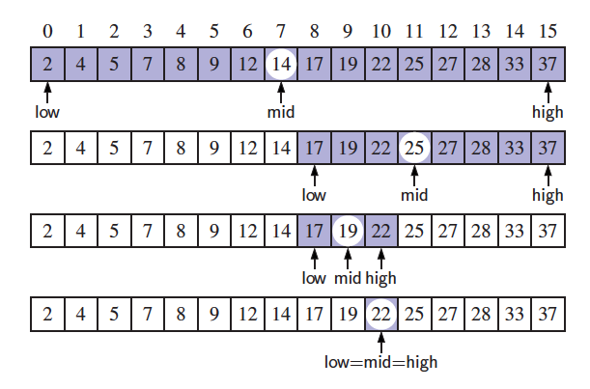
Binary Search
Search for an integer in an ordered list
We compare the target value to the median element
mid = ⌊(low+high)/2⌋
Where initially low=0 and high = n-1
We consider three cases:
If the target equals data[mid], then we have found the target.
If target < data[mid], then we recur on the first half of the sequence.
If target > data[mid], then we recur on the second half of the sequence.

Slide 29
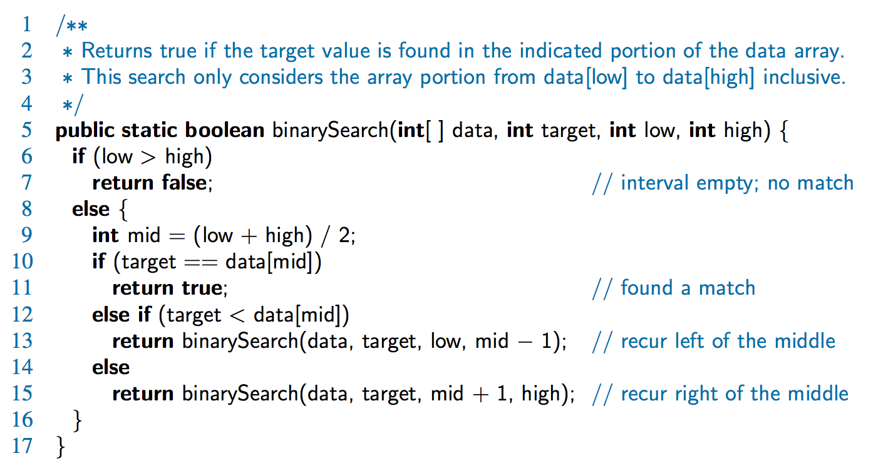
Binary Search

Slide 30
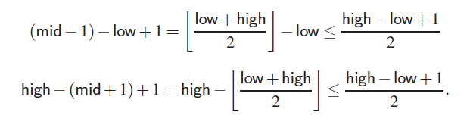
Analyzing Binary Search
Runs in O(log n) time.
The remaining portion of the list is of size high – low + 1
After one comparison, this becomes one of the following:
Thus, each recursive call divides the search region in half; hence, there can be at most log n levels

Slide 31
Defining Arguments for Recursion
In creating recursive methods, it is important to define the methods in ways that facilitate recursion.
This sometimes requires we define additional parameters that are passed to the method.
For example, we define below the array reversal method as ReverseArray(A, i, j), not ReverseArray(A).
Algorithm ReverseArray(A, i, j):
Input: An array A and nonnegative integer indices i and j
Output: The reversal of the elements in A starting at index i and ending at j
if i < j then
Swap A[i] and A[ j]
ReverseArray(A, i + 1, j - 1)
return

Slide 32
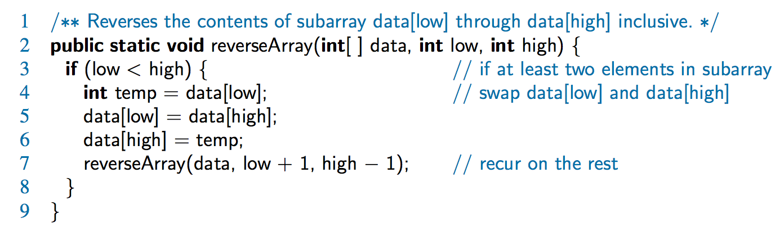
Coding & Visualizing ReverseArray

Slide 33
Binary recursion
Binary recursion occurs whenever there are two recursive calls for each non-base case.
Example: summing the n elements of an integer array A.
recursively summing the elements in the first half of A;
recursively summing the elements in the second half of A;
Then adding these two values together.
Algorithm BinarySum(A, i, n):
Input: An array A and integers i and n
Output: The sum of the n integers in A starting at index i
if n = 1 then
return A[i ]
return BinarySum(A, i, n/ 2) + BinarySum(A, i + n/ 2, n/ 2)
public static int BinarySum(int A[], int i, int n){
if (n = 1) return A[i ];
else return BinarySum(A, i, n/ 2) + BinarySum(A, i + n/ 2, n/ 2);
}

Slide 34
BinarySum tracing (1)
A = {4,3,6,2,5, 1, 7, 9} and n = 8.
public static int BinarySum(int A[], int i, int n){
if (n = 1) return A[i ];
else return BinarySum(A, i, n/ 2) + BinarySum(A, i + n/ 2, n/ 2);
}
0
,
8
0
,
4
4
,
4
Return A[0] +A[1] = 7
0
,
2
2
,
2
4
,
2
6
,
2
Return A[1] = 3
Return A[0] = 4
0
,
1
1
,
1
2
,
1
3
,
1
4
,
1
5
,
1
6
,
1
7
,
1
BinarySum(A, 0, 1)
BinarySum(A, 1, 1)
BinarySum(A, 0, 2)
Return BinarySum(A, 0, 1)+ BinarySum(A, 1, 1);
BinarySum(A, 2, 2)
Return BinarySum(A, 0, 2)+ BinarySum(A, 2, 2);
BinarySum(A, 0, 4)
BinarySum(A, 4, 4);
Return BinarySum(A, 0, 4)+ BinarySum(A, 4, 4);

Slide 35
BinarySum tracing (2)
A = {4,3,6,2,5, 1, 7, 9} and n = 8.
public static int BinarySum(int A[], int i, int n){
if (n = 1) return A[i ];
else return BinarySum(A, i, n/ 2) + BinarySum(A, i + n/ 2, n/ 2);
}
0
,
8
Return 7+8=15
0
,
4
4
,
4
Return A[0] +A[1] = 7
Return A[2] +A[3] = 8
0
,
2
2
,
2
4
,
2
6
,
2
Return A[1] = 3
Return A[3] = 2
Return A[0] = 4
0
,
1
1
,
1
2
,
1
3
,
1
4
,
1
5
,
1
6
,
1
7
,
1
Return A[2] = 6
BinarySum(A, 2, 1)
BinarySum(A, 3, 1)
Return BinarySum(A, 2, 1)+ BinarySum(A, 3, 1);
Return BinarySum(A, 0, 2)+ BinarySum(A, 2, 2);
BinarySum(A, 4, 4);
Return BinarySum(A, 0, 4)+ BinarySum(A, 4, 4);

Slide 36
BinarySum tracing (3)
A = {4,3,6,2,5, 1, 7, 9} and n = 8.
public static int BinarySum(int A[], int i, int n){
if (n = 1) return A[i ];
else return BinarySum(A, i, n/ 2) + BinarySum(A, i + n/ 2, n/ 2);
}
0
,
8
Return 7+8=15
0
,
4
4
,
4
Return A[0] +A[1] = 7
Return A[2] +A[3] = 8
Return 5+1= 8
0
,
2
2
,
2
4
,
2
6
,
2
Return A[1] = 3
Return A[3] = 2
Return A[5] = 1
Return A[0] = 4
0
,
1
1
,
1
2
,
1
3
,
1
4
,
1
5
,
1
6
,
1
7
,
1
Return A[2] = 6
Return A[4] = 5
BinarySum(A, 4, 1)
BinarySum(A, 5, 1)
Return BinarySum(A, 4, 1)+ BinarySum(A, 5, 1);
BinarySum(A, 4, 2)
BinarySum(A, 6, 2);
Return BinarySum(A, 4, 2)+ BinarySum(A, 6, 2);
Return BinarySum(A, 0, 4)+ BinarySum(A, 4, 4);

Slide 37
BinarySum tracing (4)
A = {4,3,6,2,5, 1, 7, 9} and n = 8.
public static int BinarySum(int A[], int i, int n){
if (n = 1) return A[i ];
else return BinarySum(A, i, n/ 2) + BinarySum(A, i + n/ 2, n/ 2);
}
Return 15+ 22 = 37
0
,
8
Return 7+8=15
Return 6+ 16 = 22
0
,
4
4
,
4
Return A[0] +A[1] = 7
Return A[2] +A[3] = 8
Return 5+1= 6
Return 7+ 9 =16
0
,
2
2
,
2
4
,
2
6
,
2
Return A[1] = 3
Return A[3] = 2
Return A[5] = 1
Return A[0] = 4
0
,
1
1
,
1
2
,
1
3
,
1
4
,
1
5
,
1
6
,
1
7
,
1
Return A[2] = 6
Return A[4] = 5
Return A[6] = 7
Return A[7] = 9
BinarySum(A, 6, 1);
BinarySum(A, 7, 1);
Return BinarySum(A, 6, 1)+ BinarySum(A, 7, 1)
Return BinarySum(A, 4, 2)+ BinarySum(A, 6, 2);
Return BinarySum(A, 0, 4)+ BinarySum(A, 4, 4);

Slide 38
Fibonacci numbers
Computing Fibonacci Numbers
Fibonacci numbers:
0, 1, 1, 2, 3, 5, 8, 13, 21, 34, ...
where each number is the sum of the preceding two.
Recursive definition:
F(0) = 0;
F(1) = 1;
F(i) = F(i-1)+ F(i-2); for i > 1.
Recursive algorithm :
Algorithm BinaryFib(k):
Input: Nonnegative integer k
Output: The kth Fibonacci number F_{k}
if k = 1 then
return k
else
return BinaryFib(k - 1) + BinaryFib(k - 2)

Slide 39
Trace a Fibonacci Number
public static int fib(int num){
if (num == 0) return 0;
if (num == 1) return 1;
return
(fib(num-1)+fib(num-2));
}
Assume the input number is 4, that is, num=4:
fib(4):
4 == 0 ? No; 4 == 1? No.
fib(4) = fib(3) + fib(2)
fib(3):
3 == 0 ? No; 3 == 1? No.
fib(3) = fib(2) + fib(1)
fib(2):
2 == 0? No; 2==1? No.
fib(2) = fib(1)+fib(0)
fib(1):
1== 0 ? No; 1 == 1? Yes.
fib(1) = 1;
return fib(1);

Slide 40
Trace a Fibonacci Number
fib(0):
0 == 0 ? Yes.
fib(0) = 0;
return fib(0);
fib(2) = 1 + 0 = 1;
return fib(2);
fib(3) = 1 + fib(1)
fib(1):
1 == 0 ? No; 1 == 1? Yes
fib(1) = 1;
return fib(1);
fib(3) = 1 + 1 = 2;
return fib(3)

Slide 41
Trace a Fibonacci Number
fib(2):
2 == 0 ? No; 2 == 1? No.
fib(2) = fib(1) + fib(0)
fib(1):
1== 0 ? No; 1 == 1? Yes.
fib(1) = 1;
return fib(1);
fib(0):
0 == 0 ? Yes.
fib(0) = 0;
return fib(0);
fib(2) = 1 + 0 = 1;
return fib(2);
fib(4) = fib(3) + fib(2)
= 2 + 1 = 3;
return fib(4);

Slide 42
Recursive tracing
Consider the following recursive method:
public static int mystery(int n) {
if (n < 10) {
return (10 * n) + n;
} else {
int a = mystery(n / 10);
int b = mystery(n % 10);
return (100 * a) + b;
}
}
What is the result of the following call?
mystery(348)

Slide 43
A recursive trace 2
mystery(348)
int a = mystery(34);
int a = mystery(3);
return (10 * 3) + 3; // 33
int b = mystery(4);
return (10 * 4) + 4; // 44
return (100 * 33) + 44; // 3344
int b = mystery(8);
return (10 * 8) + 8; // 88
return (100 * 3344) + 88; // 334488
What is this method really doing?

Slide 44
Exercise
Write a recursive method isPalindrome accepts a String and returns true if it reads the same forwards as backwards.
isPalindrome("madam") → true
isPalindrome("racecar") → true
isPalindrome("step on no pets") → true
isPalindrome("able was I ere I saw elba") → true
isPalindrome("Java") → false
isPalindrome("rotater") → false
isPalindrome("byebye") → false
isPalindrome("notion") → false

Slide 45
Helper method
public static boolean isPalindrome(String s) {
if (s.length() < 2)
return true; // base case
else if (s.charAt(0) != s.charAt(s.length() - 1))
return false;
else return isPalindrome(s.substring(1, s.length() - 1);
}
The preceding recursive isPalindrome method is not efficient, because it creates a new string for every recursive call. To avoid creating new strings, use a helper method:
private static bool isPalindrome(String s, int low, int high){
if (high <= low) // Base case
return true;
else if (s.charAt(low) != s.charAt(high) ) // Base case
return false;
else
return isPalindrome(s, low + 1, high - 1);
}
public static bool isPalindrome(final String s){
return isPalindrome(s, 0, s.length - 1);
}

Slide 46
helper methods for recursive linked list functions
public int size(){
IntNode v = head;
return size(v);
}
private int size(IntNode v){ //private
if (v==null) return 0;
else return 1 + size(v.next);
}
public void addEnd(int value) {
if (head==null)
head = new IntNode(value);
else {
IntNode current = head;
addEnd(current, value);
}
}
private void addEnd(IntNode current, int value){
if (current.next==null)
current.next = new IntNode(value);
else
addEnd(current.next, value);
}

Slide 47
Final Thoughts
We have to pay a price for recursion:
calling a function consumes more time and memory than adjusting a loop counter.
high performance applications (graphic action games, simulations of nuclear explosions) hardly ever use recursion.
In less demanding applications recursion is an attractive alternative for iteration (for the right problems!)

